Slide 1
The Nature of Americans A National Initiative to Understand and Connect Americans and Nature NatureofAmericans.org
Dr. Stephen R. Kellert
Yale University
David J. Case, Dr. Daniel Escher, Dr. Daniel J. Witter,
Dr. Jessica Mikels-Carrasco, Phil T. Seng
DJ Case & Associates
Notes:
Thank you, Steve.
Profound changes are occurring in the American public’s connections to nature, the outdoors, and wildlife. At the same time, there is a growing body of evidence that contact with nature is not just a recreational amenity, but is fundamental to human health and wellbeing.

Slide 2
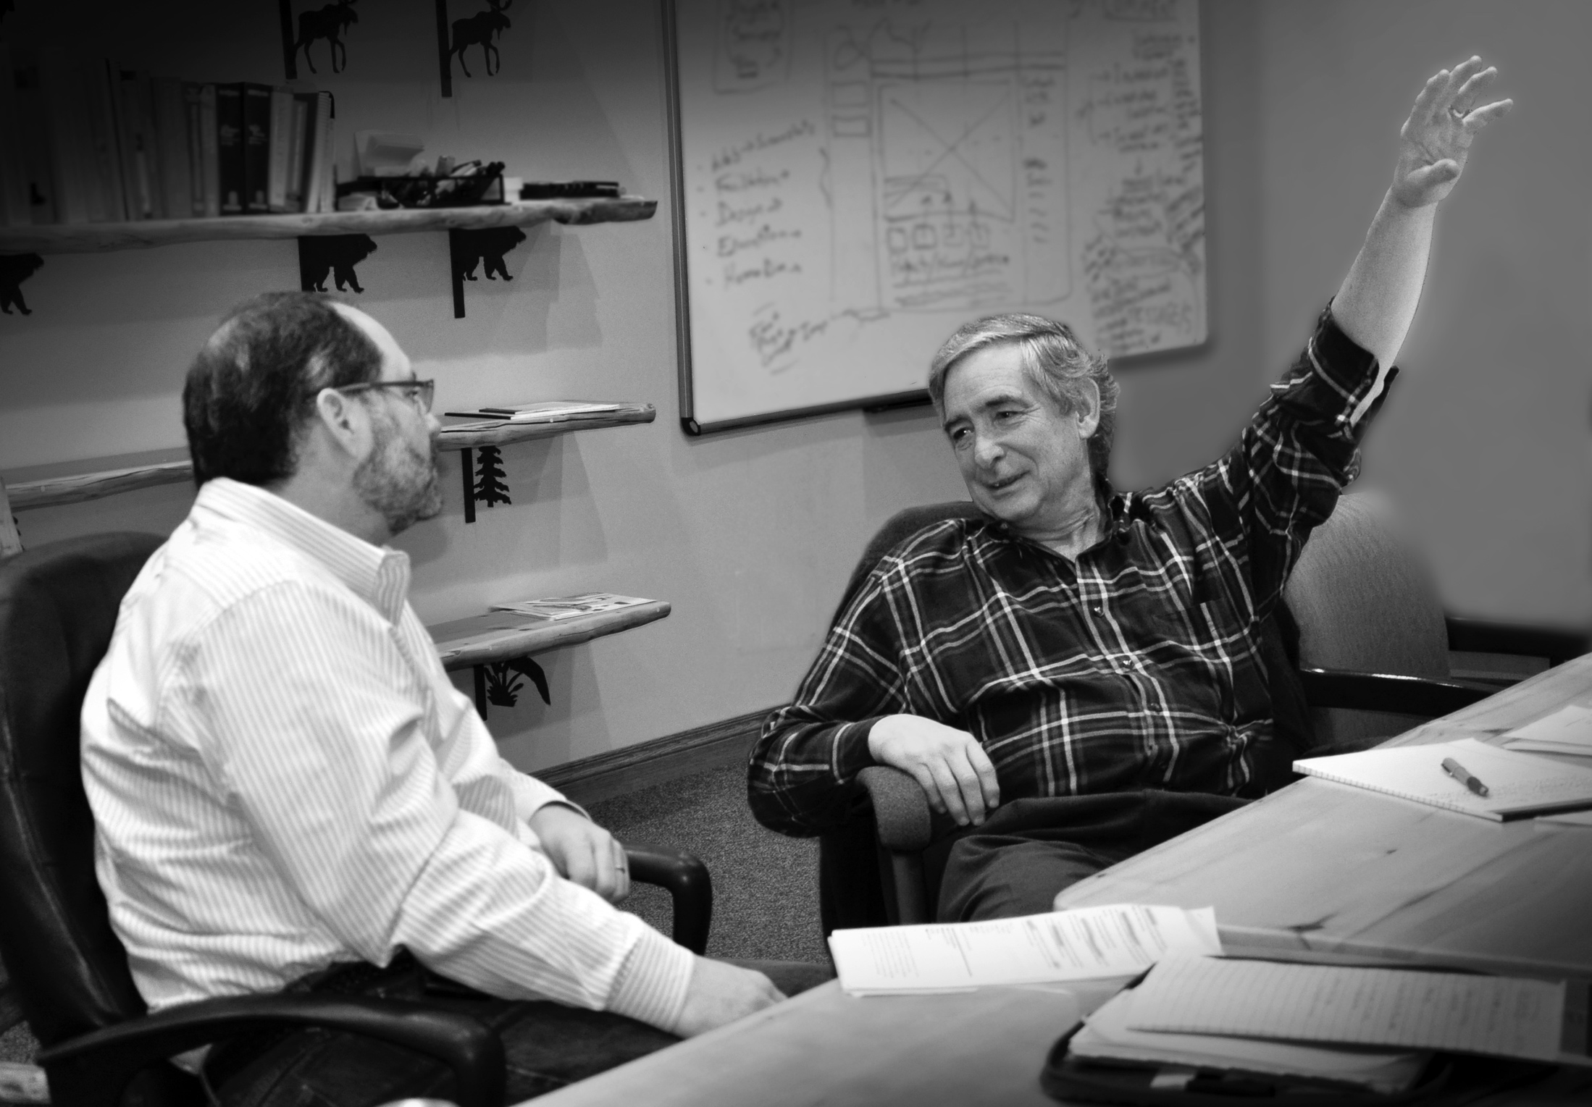
Notes:
In 2011, DJ Case staff gathered with Dr. Stephen Kellert at our office to explore how to better understand and foster Americans’ relationship with nature.
As Steve Williams said, Dr. Kellert has been a leader, I would offer THE LEADER, in researching and articulating the importance of contact with nature to human health and wellbeing.
The result of that meeting in 2011 was “The Nature of Americans—a national initiative to understand and connect Americans and Nature,” the subject of my comments this morning.
It has been an honor for the social scientists and other staff at DJ Case to work alongside Dr. Kellert…and it is a privilege to stand here before you this morning to share some of the results of this unprecedented effort.

Slide 3
Texas Parks and Wildlife Department
Fish and Wildlife Foundation of Florida
Florida Fish and Wildlife Conservation Commission
U.S. Fish and Wildlife Service
Disney Conservation Fund
Wildlife Management Institute
Morrison Family Foundation
Yale School of Forestry & Environmental Studies
DJ Case & Associates
Notes:
I’d like to extend my gratitude to the partners in this Initiative. Special thanks go to Carter Smith, Director in Texas, Nick Wiley, Director in Florida, former USFWS Director Dan Ashe, and Kim Sams and Beth Stephens at Disney for their early leadership and support.

Slide 4
15
Focus groups with adults
10,156
Online survey of adults
Interviews with children & survey of parents
771
771
8–12 year-olds / Parents
Notes:
The “understanding” part of the Initiative included 3 major research efforts conducted in 2015 and 16:
focus groups across the country with a wide spectrum of adult Americans
a representative online survey of over 10,000 adult Americans
Interviews with 771, 8 to 12 year old children conducted webcam to webcam. For each of those children, we also conducted an online survey of one of their parents.
We have a mountain of data…in fact a whole mountain RANGE of results, findings, and recommendations. This presentation is really a sneak peek at the results, if you will…formal public release of the results will begin on April 19.
What I’m going to do this morning is:
First, talk about Americans’ disconnection from nature
Second, contrast that to the American’s interest in nature
And finally, share 5 recommendations for the conservation community

Slide 5
Notes:
I almost don’t need to describe the things that disconnect Americans from nature in daily life. You see them every day in your families, in your friends, and in your own lives.
Let me describe three reasons for disconnection that the American public shared with us.

Slide 6
Competing priorities
Work and home, go put the kids to bed. That’s pretty much all we have time for.
white woman, late 30s, some college, middle income
Notes:
The first source of disconnection is competing priorities.
Americans face competing priorities for their time, attention, and money. They have children, long commutes, and exhausting jobs. The mother of a young child told us in a focus group: “Work and home, go put the kids to bed. That’s pretty much all we have time for.”

Slide 7
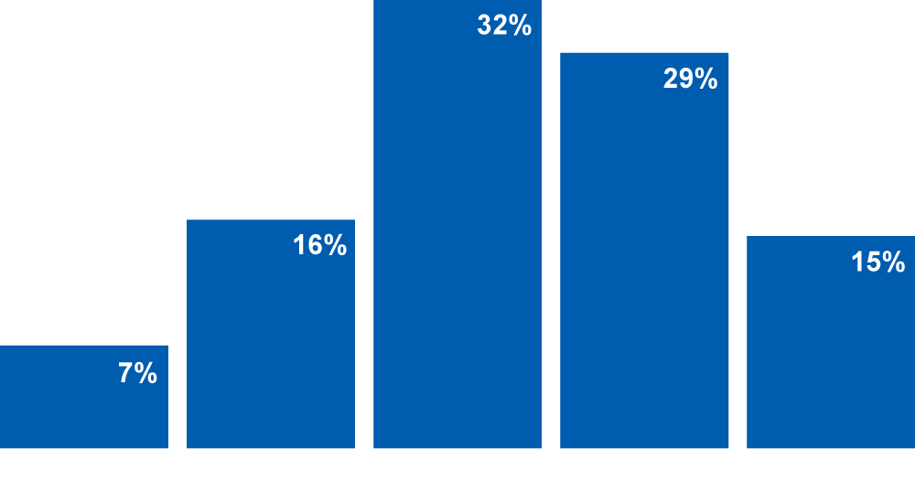
Adults: There are many more important issues in my life than my concern for nature
Notes:
She was not alone: almost half of the adults we surveyed across the US agreed with the statement: “There are more important issues in my life than my concern for nature.”
[PAUSE]

Slide 8
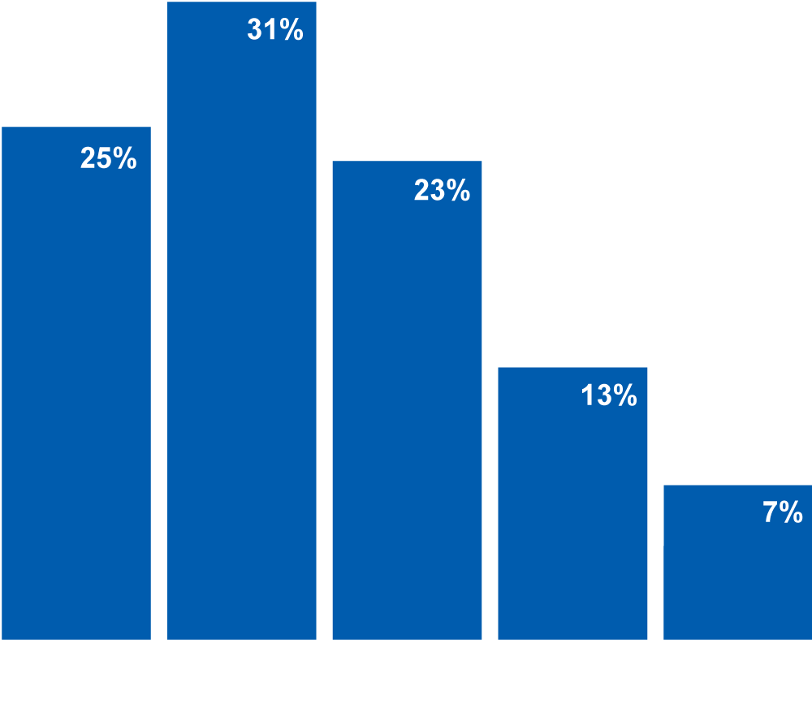
Adults: In a typical week, when weather allows, about how many hours do you spend outside in nature?
Notes:
One of the effects of competing priorities is that Americans spend relatively little time outside in nature. Over half said they spend less than 5 hours a week outside.
Most Americans are spending their time indoors.

Slide 9
Shared expectations
Once you [did] your homework, you [went] outside.
- black man, late 40s, HS degree, low income
Notes:
From our study, we heard about a second reason for disconnection from nature.
Among adult Americans, shared expectations about what “good” connection to nature looks like have changed.
Older adults observed how it used to be normal to spend time exploring, playing, and discovering outdoors. Now they worry because it’s not the same for their children and grandchildren. This was a theme we heard over and over among adults: they are genuinely concerned about younger generations growing up without the same nature experiences that were so positive and important to them.

Slide 10
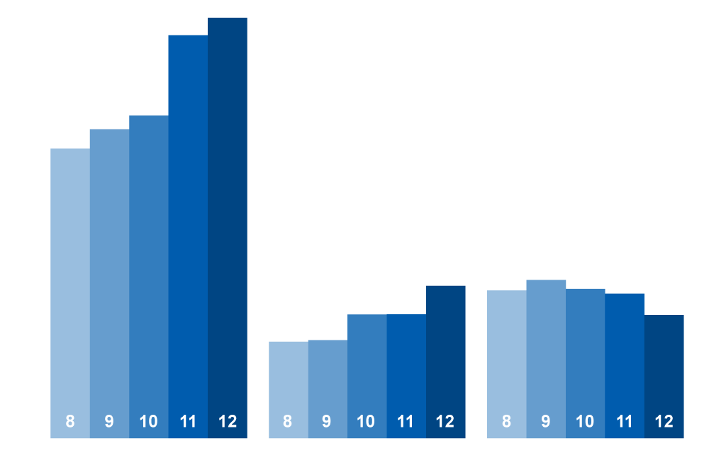
Parents: In a typical week, how much time does your child spend on the following activities?
Notes:
If the shared expectation used to be that kids spent most of their time playing outdoors, that is no longer the case.
We asked parents: “In a typical week, how much time does your child spend on the following activities?”
There was a long list of activities and they are grouped here and reported by age.
As you can see on the left side of the chart, time on computers and TV towers over time spent outdoors. And this increases with age from 8 to 12, while time spent outdoors decreases as children get older.

Slide 11
Adults: On average, how satisfied are you with the amount of time you're able to get outdoors to experience nature?
Satisfied
Neutral
Dissatisfied
47%
34%
20%
2 hours or less per week
Notes:
Here’s a second of example of shifting expectations.
Most adults in our study reported spending relatively little time outside in nature each week. And most were satisfied with the little time they did spend in nature.
The group who spent 2 hours or less per week (which is not much time)—nearly half of those adults are satisfied with that amount of time.
It is becoming normal in American society to spend relatively little time outdoors. So, you can’t rely on shared expectations or general social norms to get people outdoors. You’ll have to be more explicit.
I’ll come back to the importance of shared expectations later in the presentation, when I talk about expectations Americans hold that “authentic nature” is located in faraway places and requires great effort to reach.

Slide 12
Physical places
You don’t get much of [nature] down here. Too many cars and pollution.
- Hispanic woman, late 20s, HS degree, middle income
Notes:
I’ve talked about competing priorities and shared expectations. A third reason for disconnection is the physical places where Americans live.
Americans live in physical spaces that discourage contact with the natural world and even representations of it. They mention the concrete jungle of cities, housing developments, and only low-quality parks nearby.

Slide 13
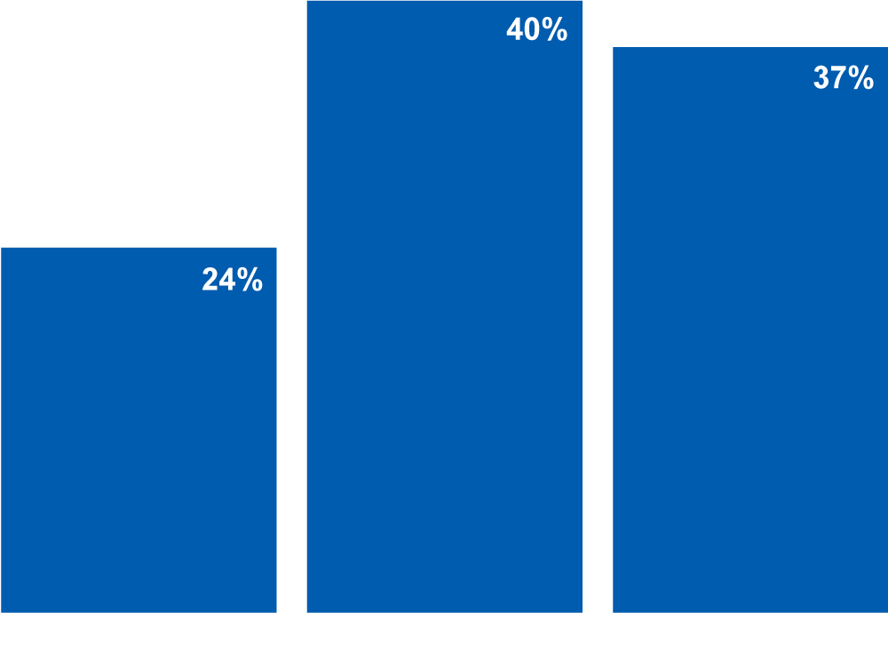
Adults: Would you say your pastimes, hobbies, and recreational interests are more...?
Notes:
Perhaps it’s not a surprise then, that so many adults say their “pastimes, hobbies, and interests are more indoors oriented”—40%. One one-quarter say their hobbies and interests are outdoors-oriented.

Slide 14
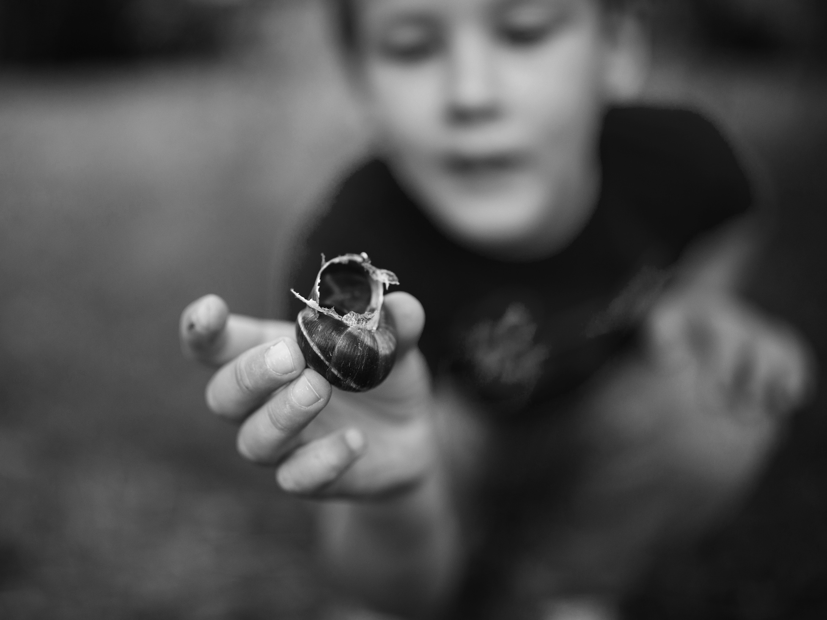
Interest in Nature
Notes:
As I’ve described, Americans encounter a number of forces that disconnect them from nature. These are society-wide issues. They are massive, and they will require all sorts of organizations and sectors to work together.
But this does not mean that the situation is hopeless. What I want to show you now is the potential for Americans to connect with nature.

Slide 15
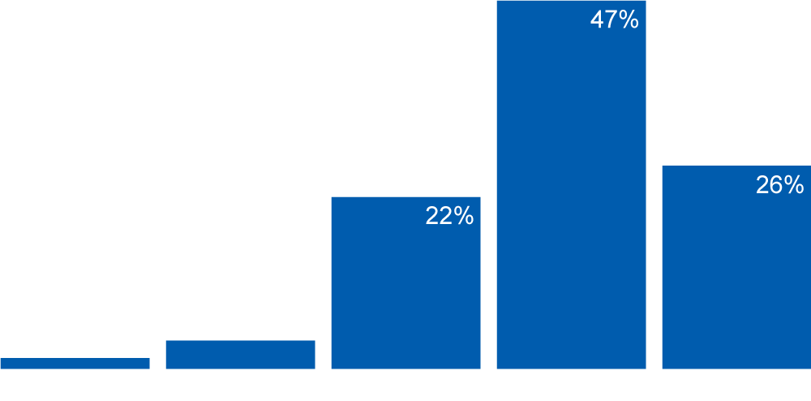
Adults: How do your interests in nature compare with your other interests?
Notes:
American adults are interested in nature. We asked: “How do your interests in nature compare with your other interests?”
A quarter of adults say their interests in nature are their most enjoyable.
And another half say it is among their more enjoyable interests.

Slide 16
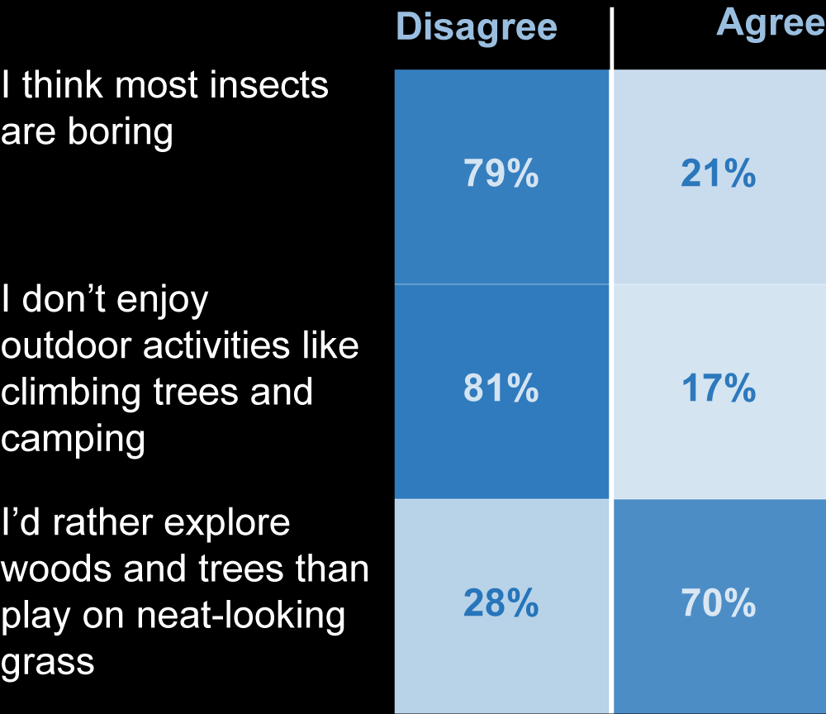
Children: Do you agree or disagree with the following statements?
Notes:
Children also enjoy nature in a number of different ways. [PAUSE]
They think insects are interesting. They enjoy activities like climbing trees and camping.
And, my favorite, 70% of the children said they would “rather explore woods and trees than play on neat-looking grass.”

Slide 17
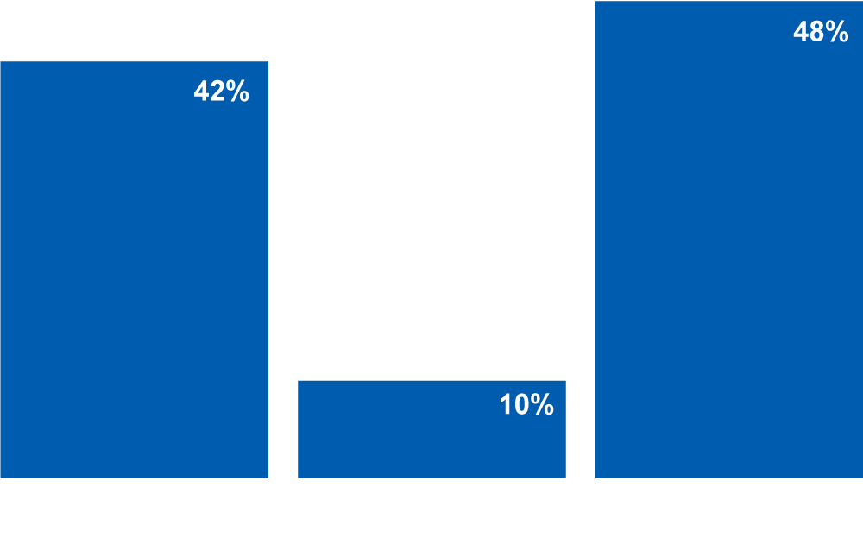
Children: Do you have more fun playing indoors, outdoors, or both?
Notes:
In fact, nature for children is fun. When asked, “Do you have more fun playing indoors or outdoors,” only 10 percent say they have more fun playing indoors.
Over 40 percent say they have more fun playing outdoors.

Slide 18
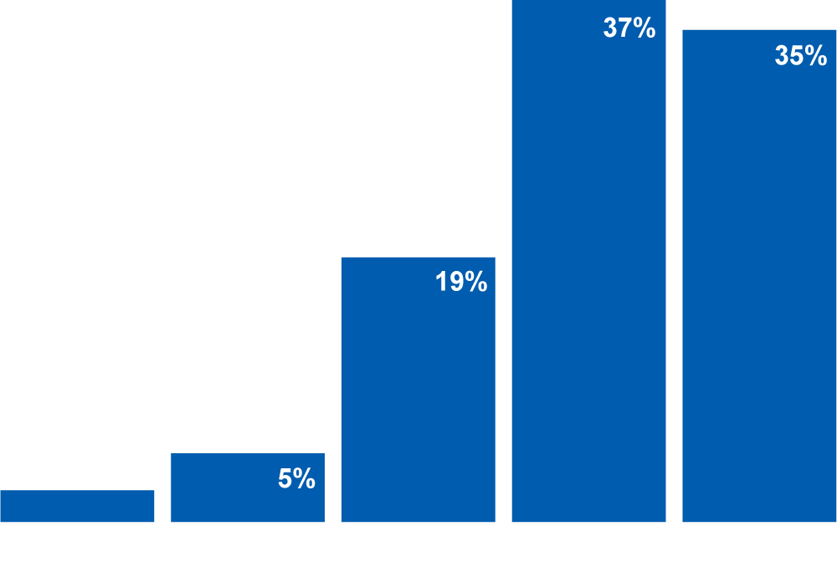
Adults: How important is
getting into nature for your
physical health?
Notes:
Alongside interest and enjoyment of nature, Americans also recognize nature’s benefits to their health and wellbeing.
3 out of 4 adults say getting into nature is very or extremely important for their physical health.

Slide 19
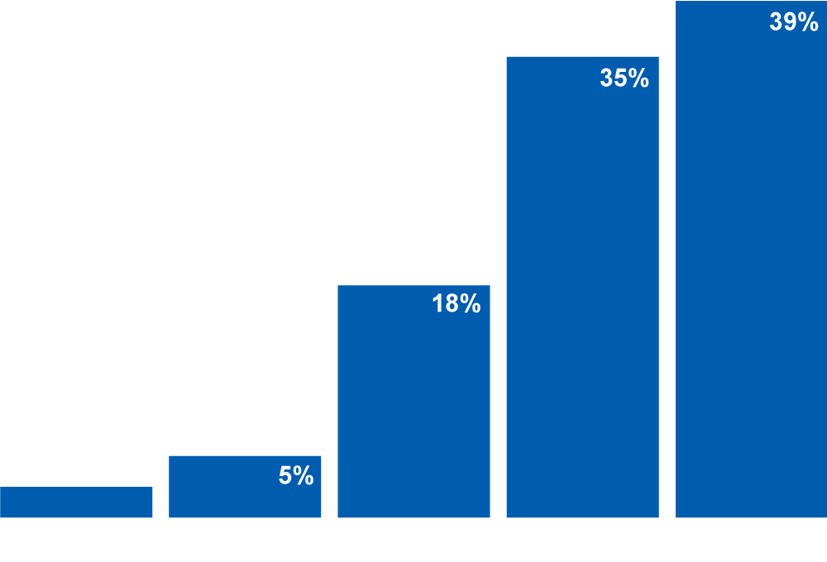
Adults: How important is
getting into nature for your emotional outlook?
Notes:
When we asked about their emotional outlook, the results were the same.
Again, 3 out of 4 said getting into nature is very or extremely important for their emotional outlook.

Slide 20
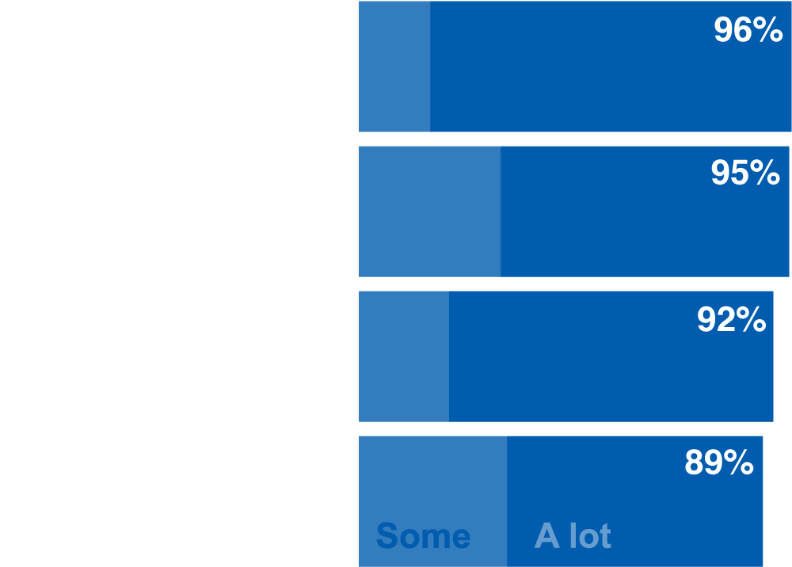
Children: How much do you think playing in the outdoors and nature has helped you with each of these parts of growing up?
Notes:
Adults are not the only ones who recognize the benefits of nature.
Children also recognize that nature helps them to grow healthy, to be happy, to enjoy family and friends, and to know that they are important and liked.

Slide 21
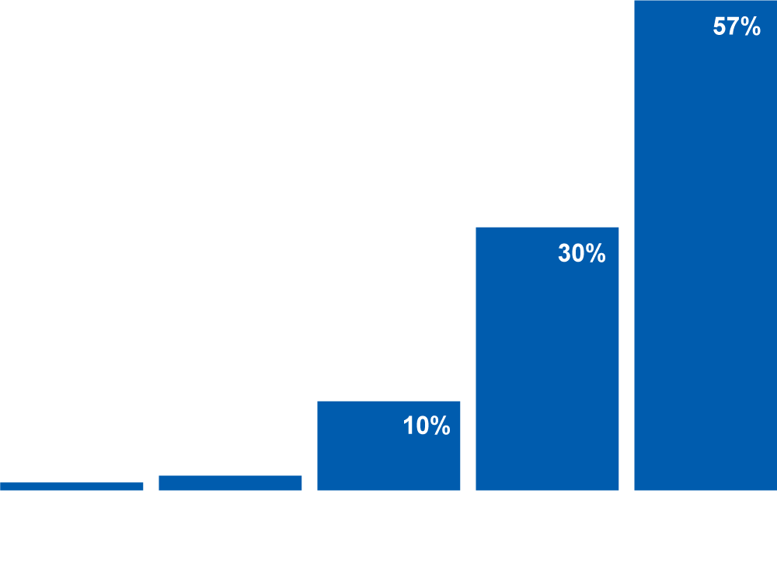
Adults: An understanding of how nature works is as important to a child’s education as learning reading, writing, and math.
Notes:
Adults see the benefit of nature not only for health and wellbeing, but also for intellectual development.
Despite the emphasis on core subjects in school, the overwhelming majority agree that “understanding how nature works is as important to a child’s education as reading, writing, and math.”
It’s important to point out that the last several slides you just reviewed are patterns that hold up across demographics—across age groups, residential location, race and ethnicity, gender, and income.

Slide 22
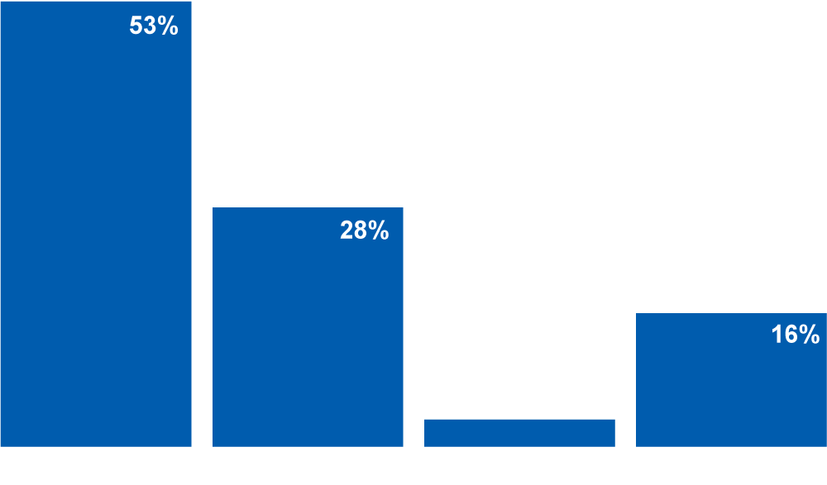
Adults: Are programs for Americans
to enjoy nature and wildlife…?
Notes:
I’ve talked about enjoyment of nature and recognition of nature’s benefits. Let’s add one more reason for optimism—support for nature programming and funding.
We asked a number of questions related to this. This is just one: “Are programs for Americans to enjoy nature and wildlife underfunded, adequately funded, or overfunded?” Half of adults think programs for Americans to enjoy nature and wildlife are underfunded. Only 3% said overfunded.

Slide 23
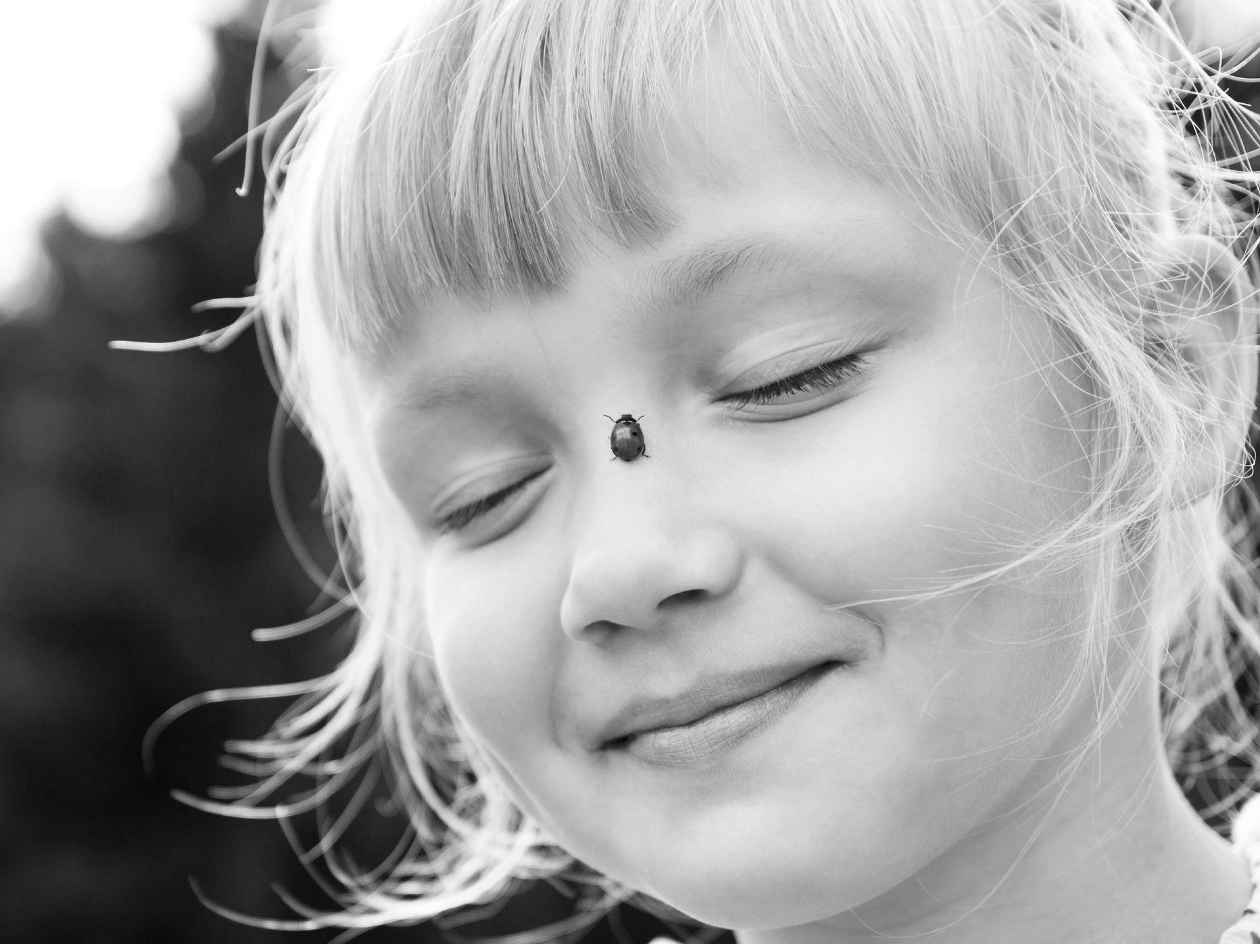
Recommendations
Notes:
There is hope…American adults and children are interested in nature, recognize nature’s benefits to them, and support nature-related programming and funding and conservation.
Yet those massive, society-wide barriers still exist. Competing priorities, shared expectations, and physical places—and unfortunately many more—work to keep children and adults disconnected from nature.
So what do you as a conservation community do to overcome the gap between interest and action?

Slide 24
1. Redefine connecting with nature
Notes:
The first recommendation is: Redefine connecting with nature. [PAUSE]

Slide 25
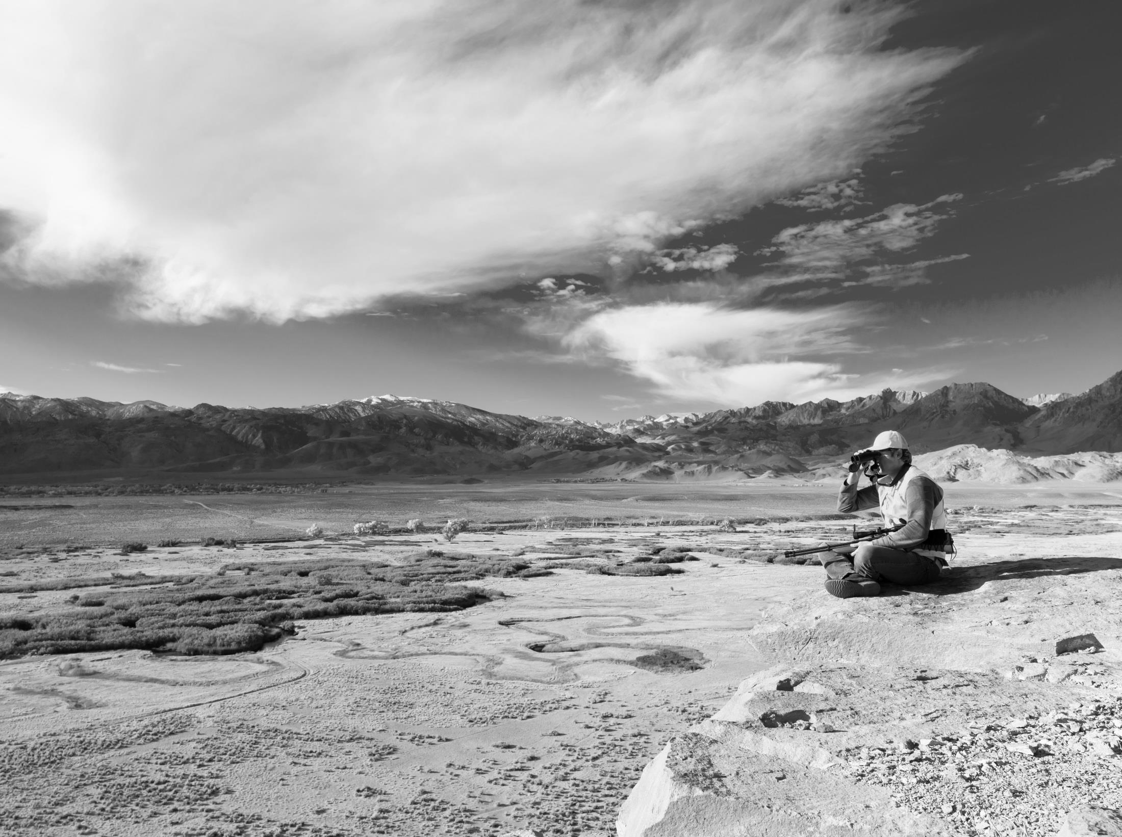
Notes:
When you all here in this room think of connecting with nature, many of you think of this—alone, immersed in a remote setting.

Slide 26
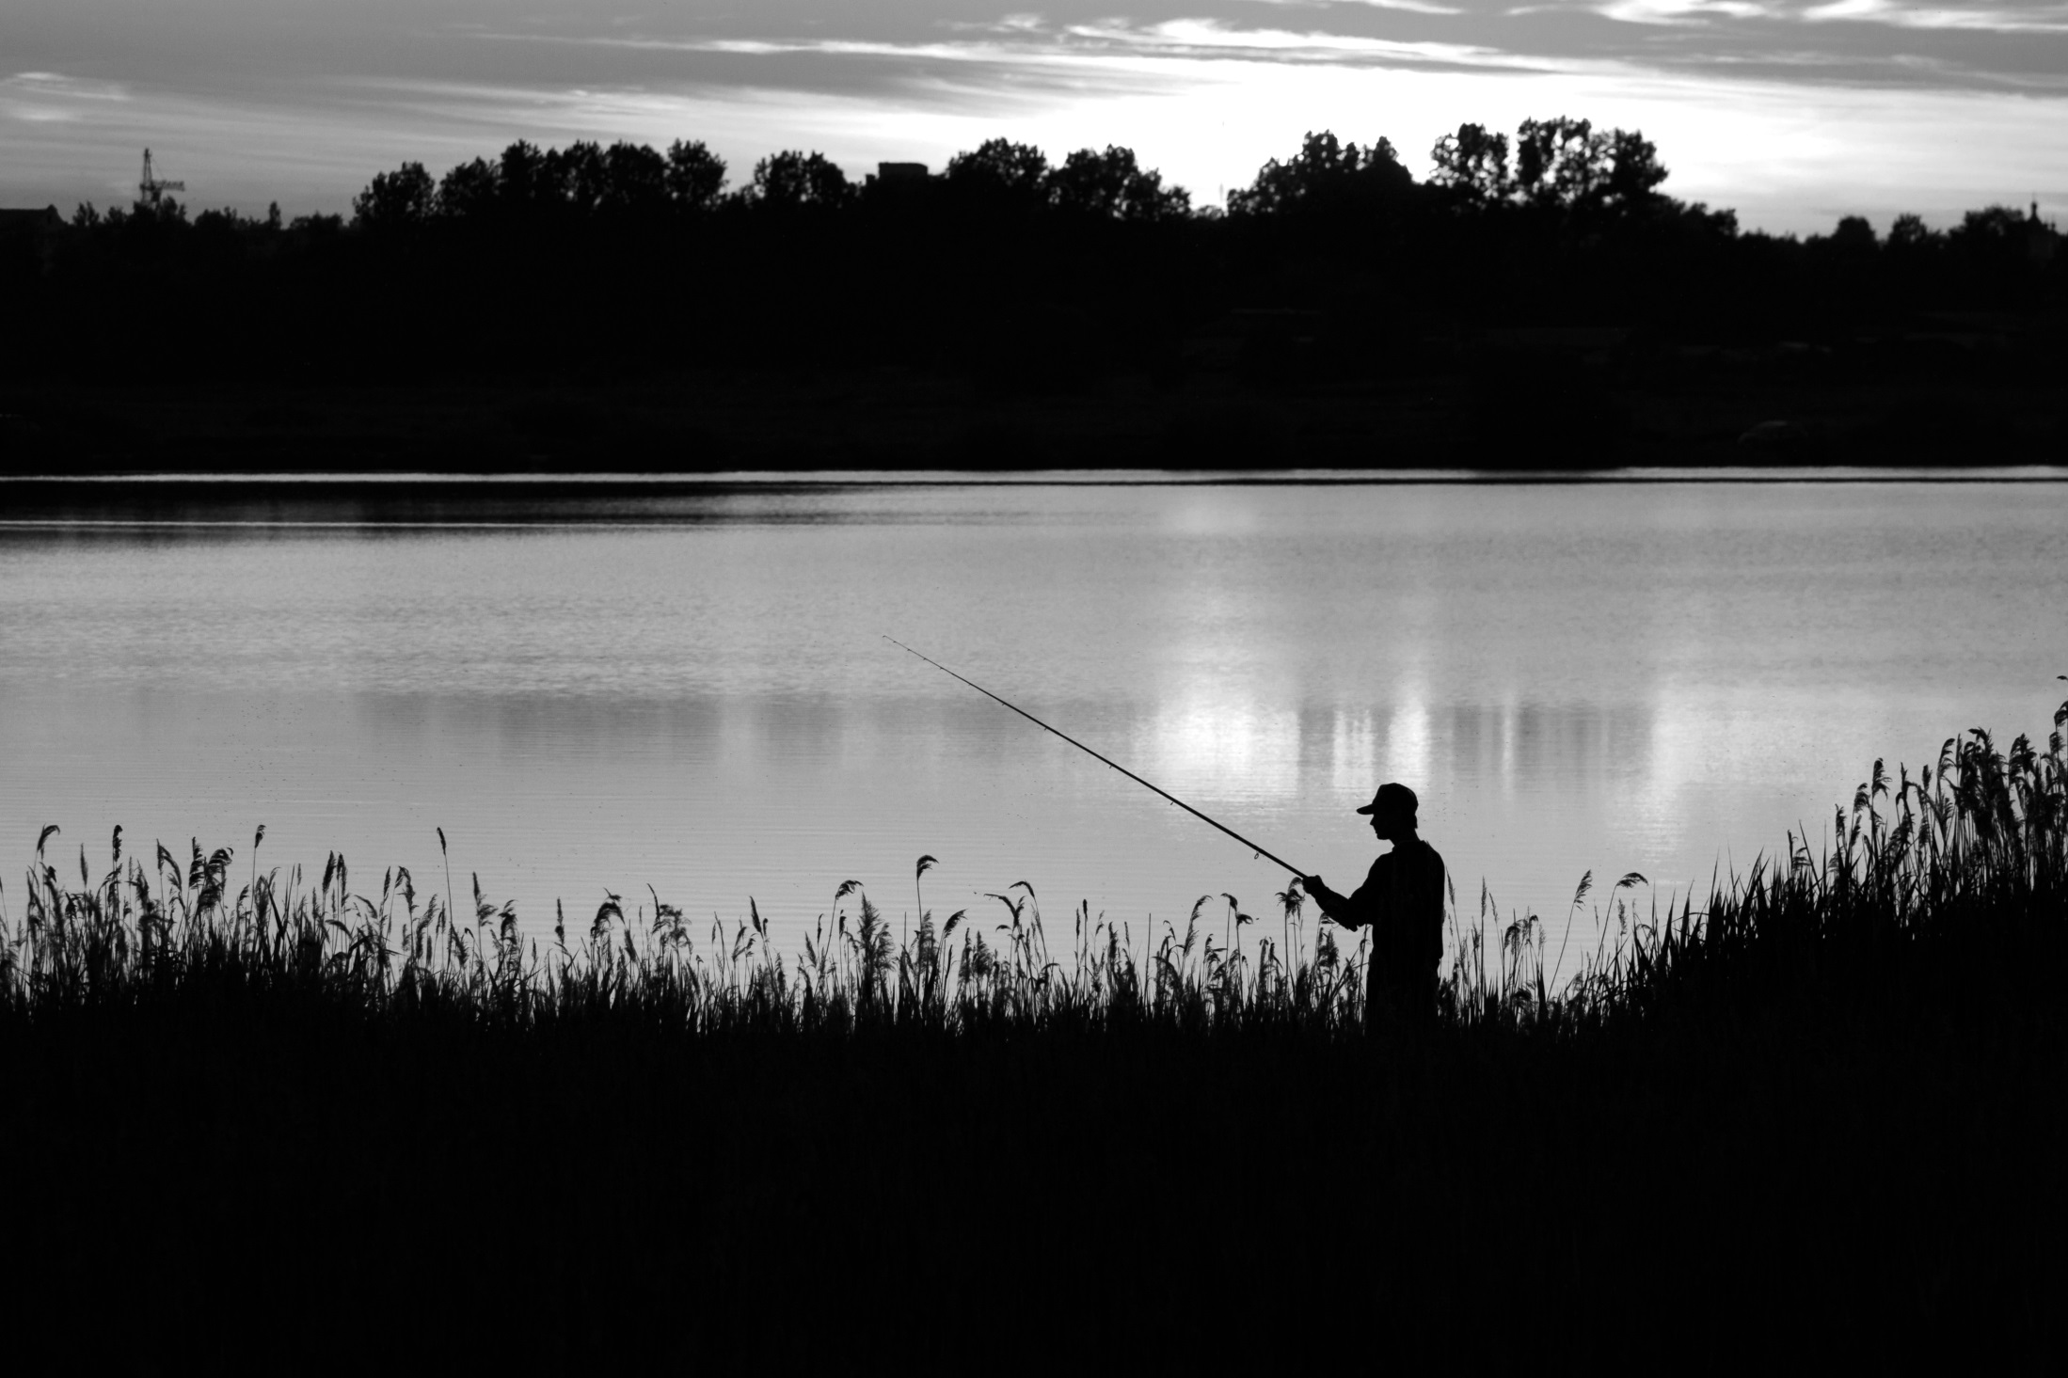
Notes:
Or this.

Slide 27
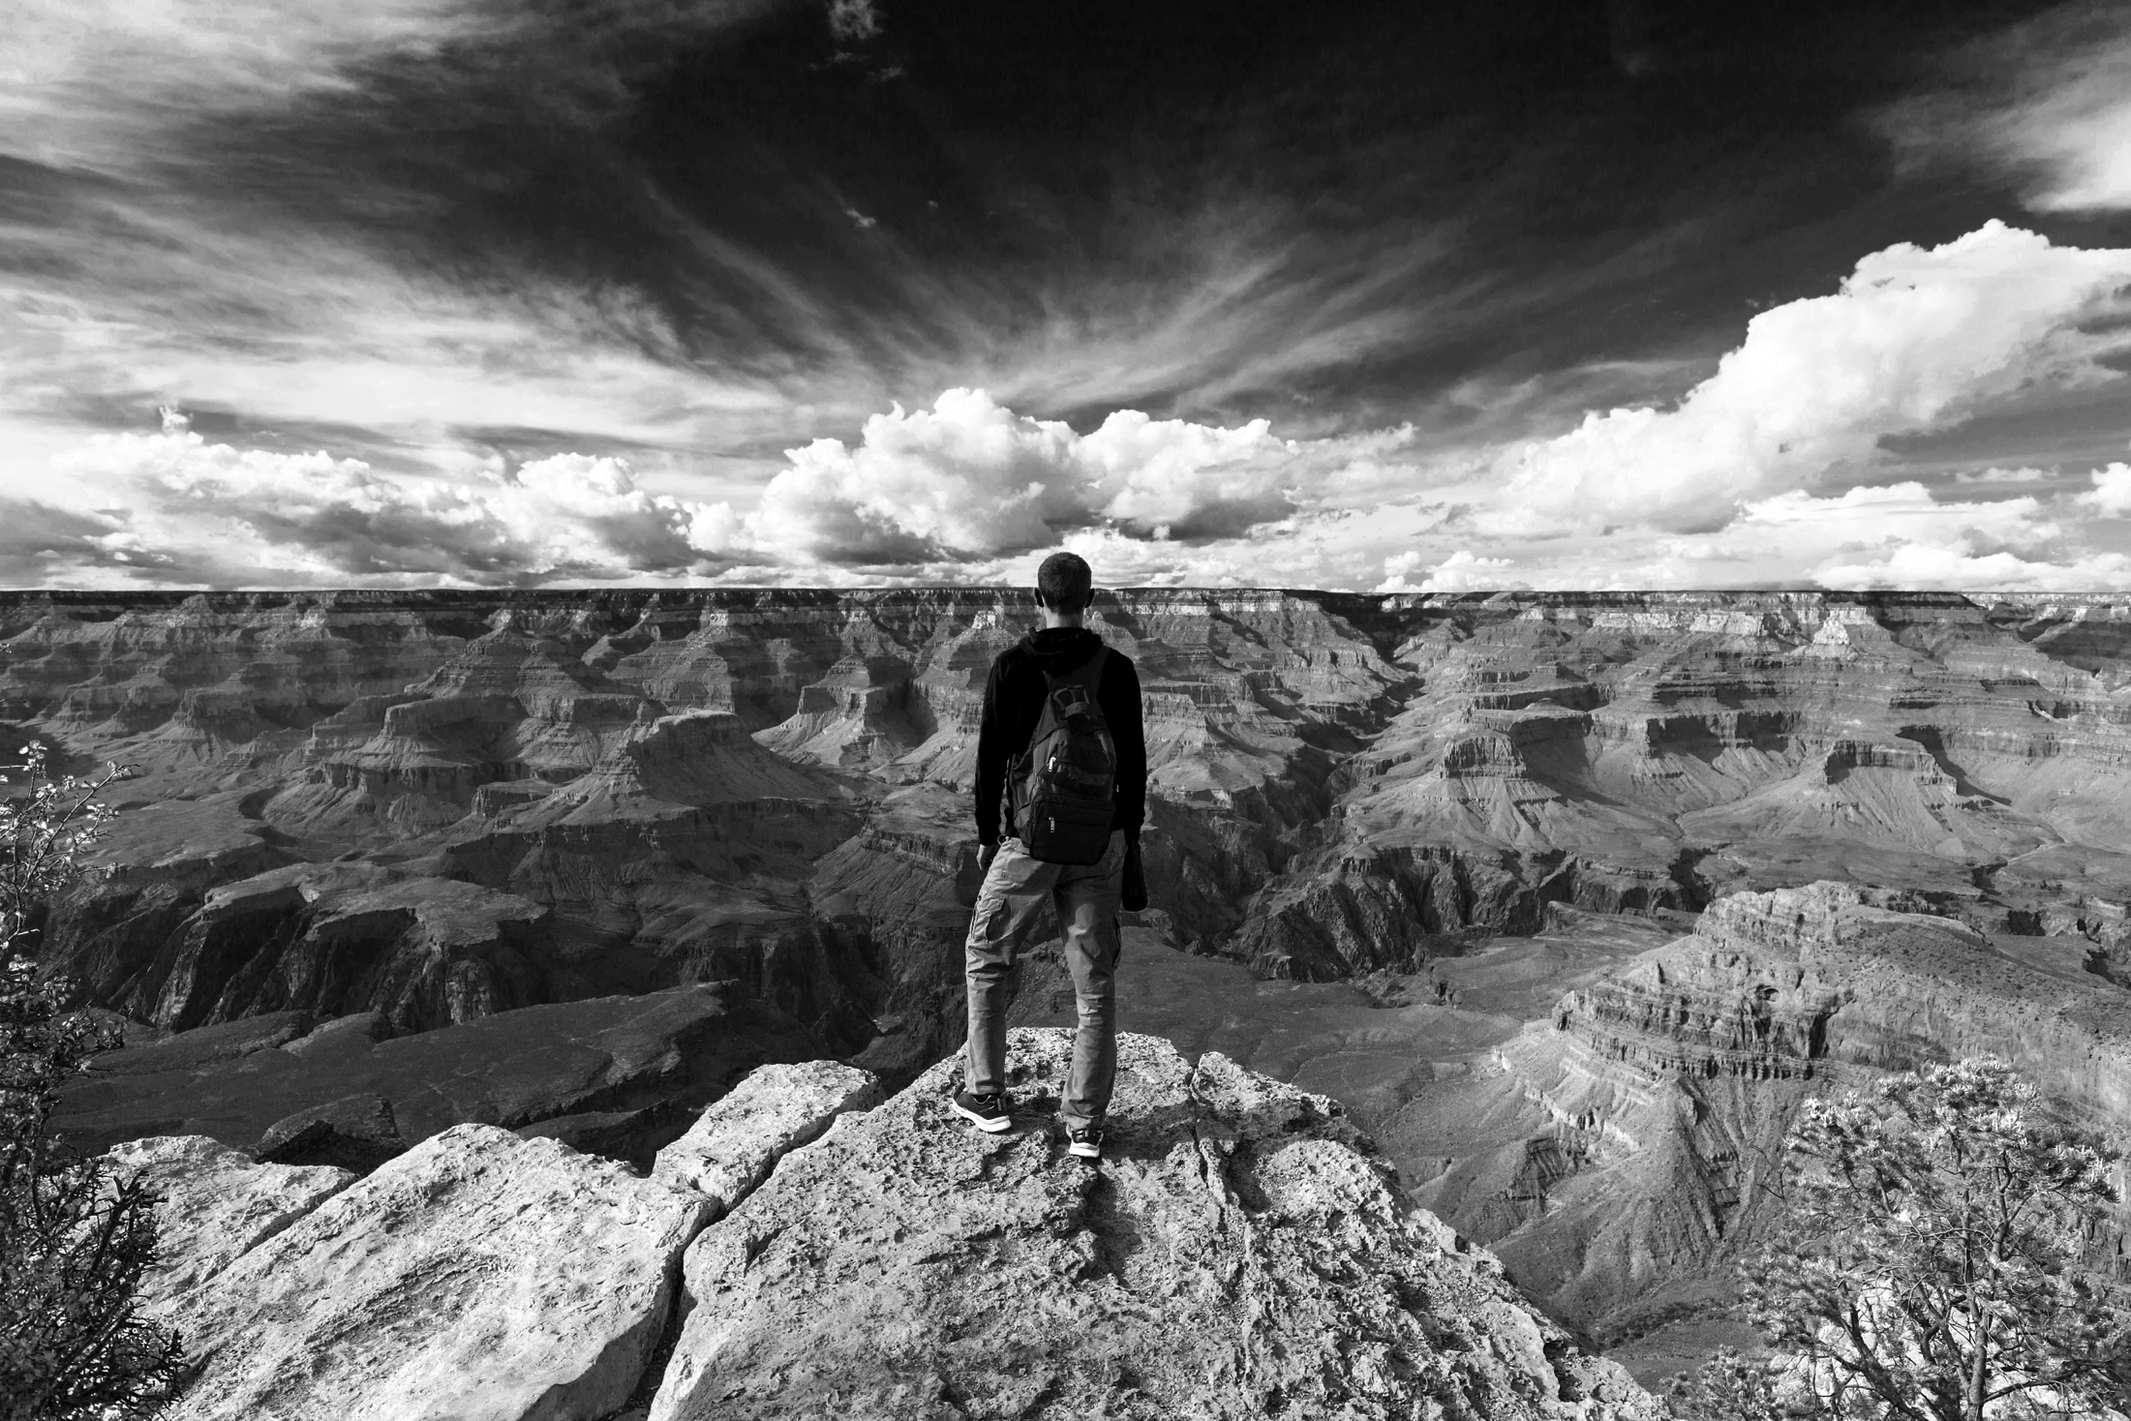
Notes:
Or this…a once-in-a-lifetime trip to an iconic place.

Slide 28
Adults: What do you think of when you hear the word “nature”?
The Grand Canyon. Nature at its best when I went…. It’s beautiful. I’d never seen it before, like nature out there by itself.
White woman, late 50s, HS degree, middle income
Notes:
And, no surprise, adults in our research have bought into these expectations about what “true” or “pure” experiences in nature require. As one respondent said, nature is “the Grand Canyon. Nature at its best when I went…. It’s beautiful. I’d never seen it before, like nature out there by itself.”
Yet what our research shows is that the majority of Americans cannot experience nature in this way. They don’t have the time or money to do it. Or even if they do have the time and money, they may be able to do it only once a year or once a lifetime.
If people are convinced the “nature” is something they can only experience at distant refuge, park or natural area, then they will miss out on the opportunity to experience nature’s benefits on a routine, day-to-day basis.

Slide 29
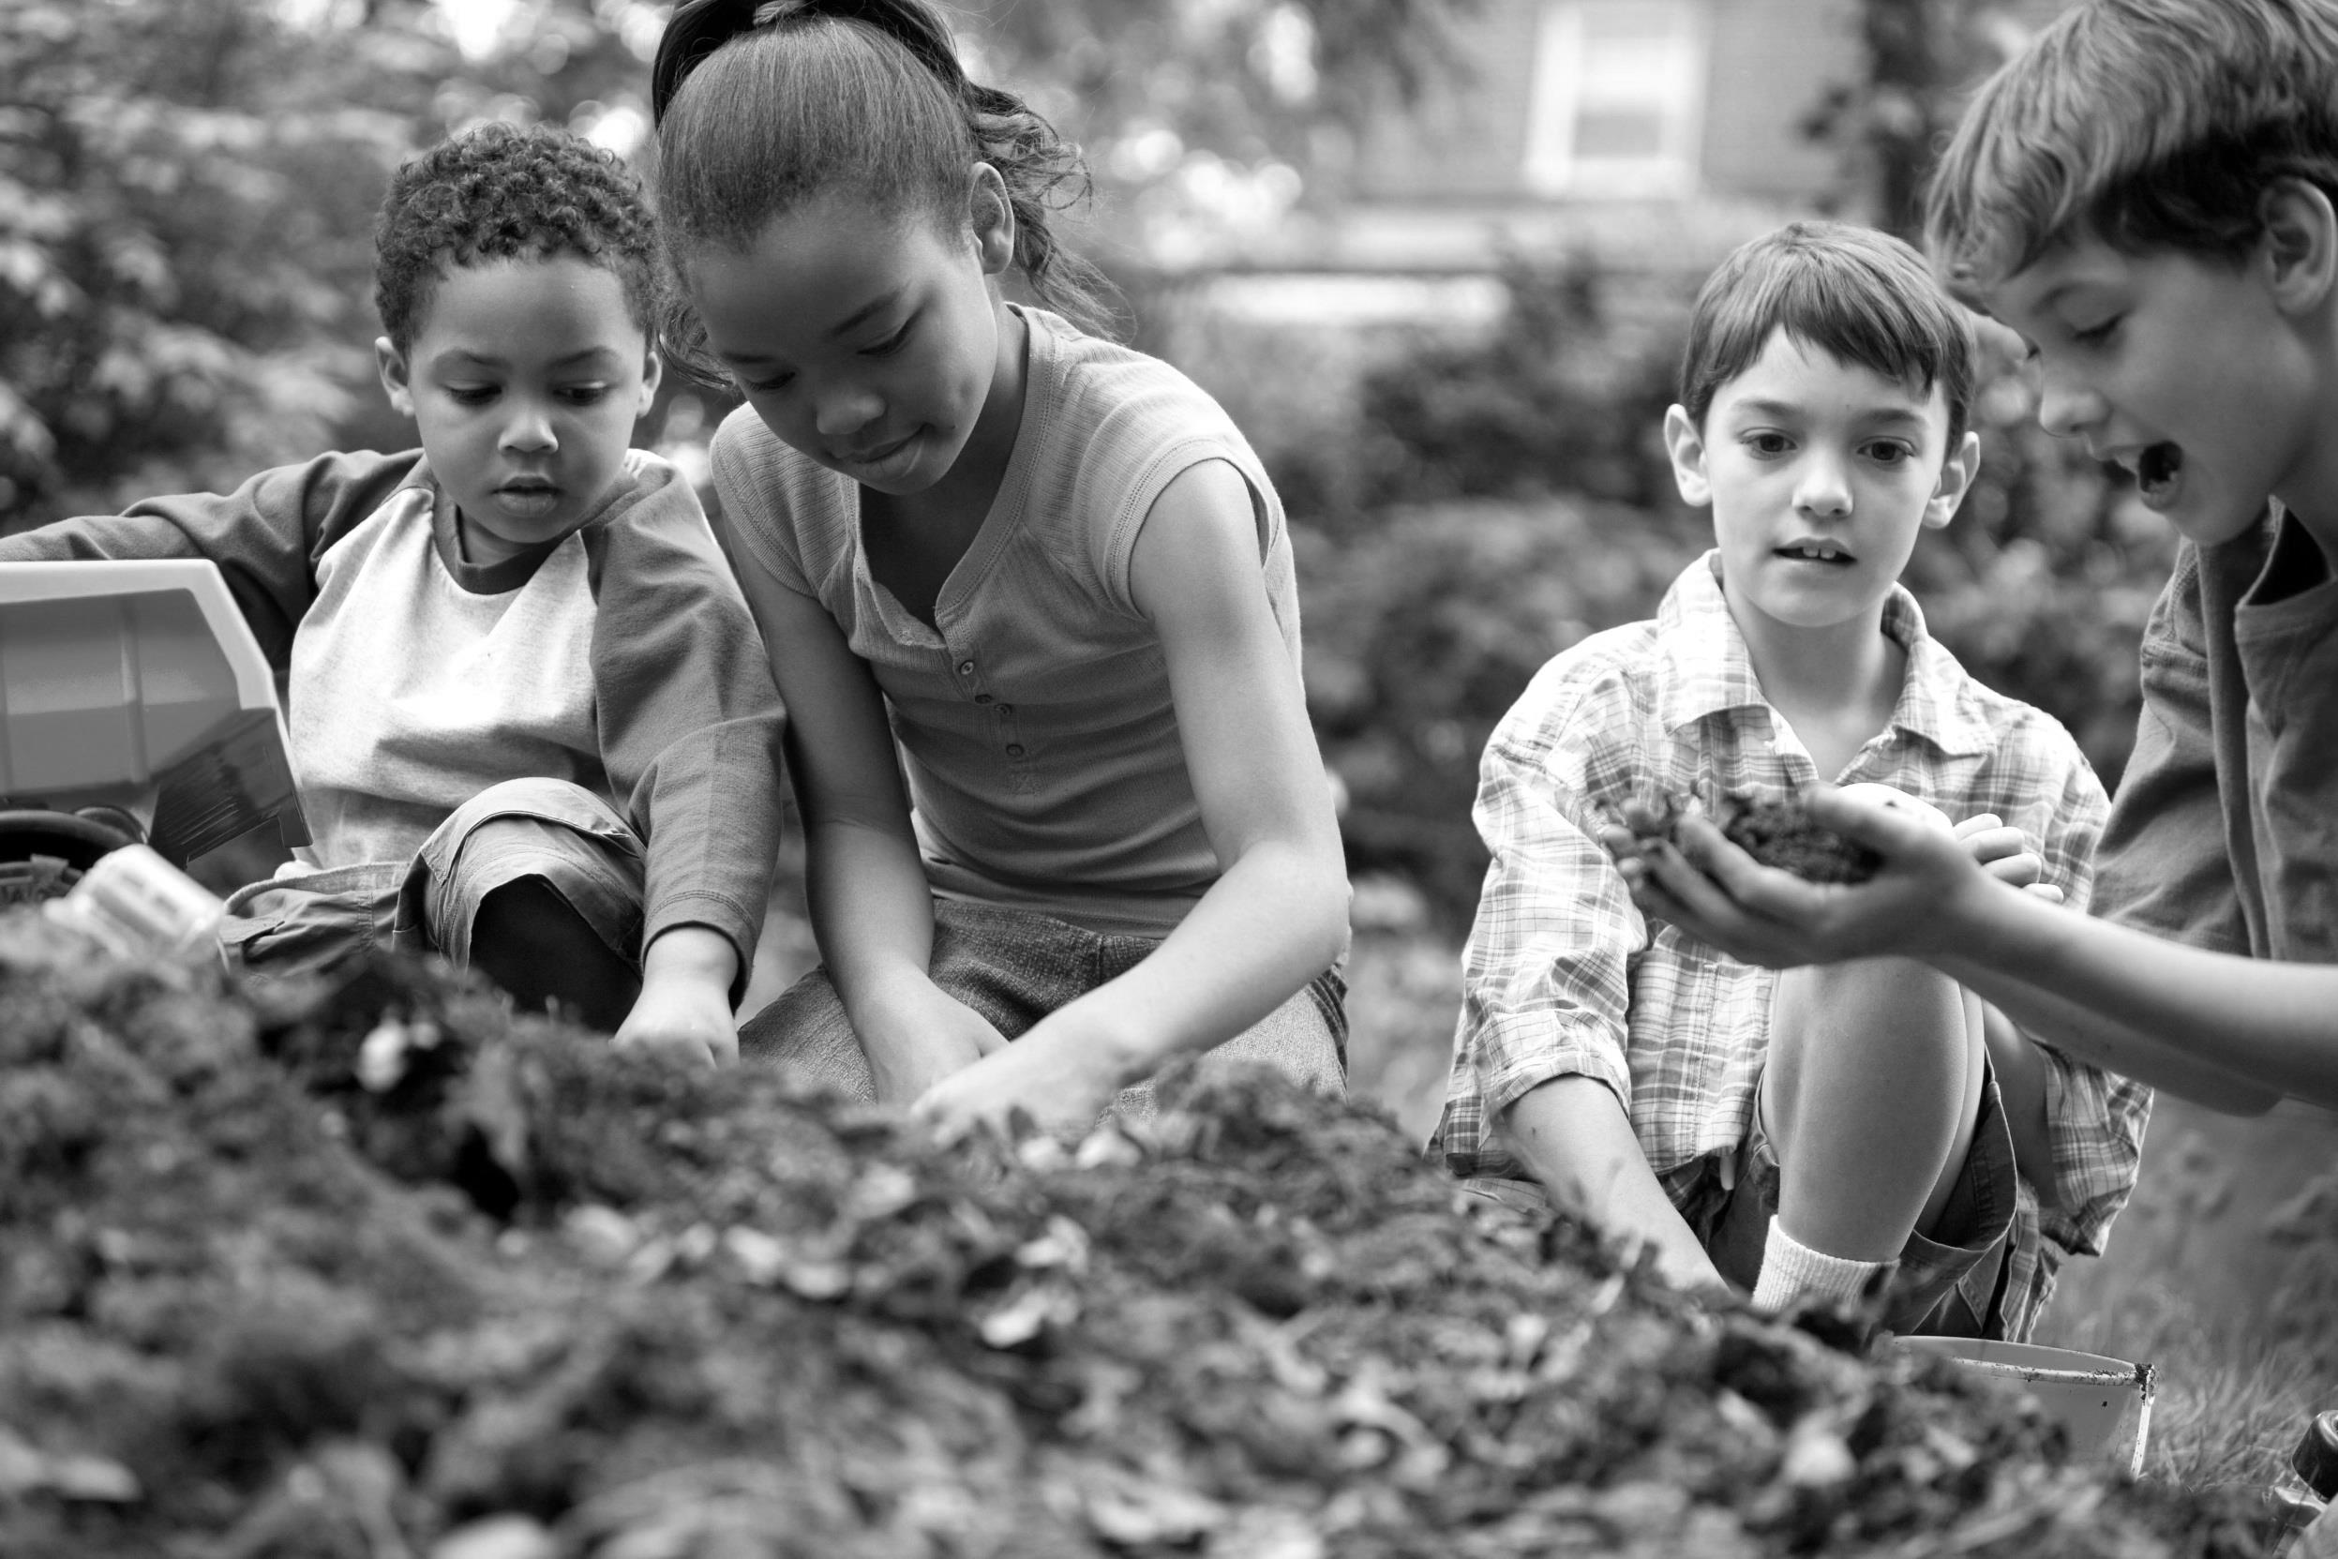
Notes:
And, our results show that children consistently place nature as local, as out the back door. For children, you don’t need to load them in the car yet again to give them times in the outdoors they will never forget, or a special place to remember.
So, connection to nature has to be redefined to include routine action, not just one-off events. It has to be expanded to included recreational activities that are not just nature-focused…in other words people can engage with nature, enjoy nature, connect with nature as part of other activities in their daily or weekly lives.

Slide 30
2. Be social
Notes:
Our second recommendation is to be social. And here I don’t mean “social media”, though that is important for other reasons.
In other words, connection to nature needs to have a social aspect. Nature experienced alone can be a powerful thing, but this is the exception, not the primary way American adults and children experience nature.
Americans are clear: When they talk about their most memorable moments and their special places outdoors, they nearly always involve other people. Americans make time for nature when they have the social support to do so and when the activities involve their friends and family.

Slide 31
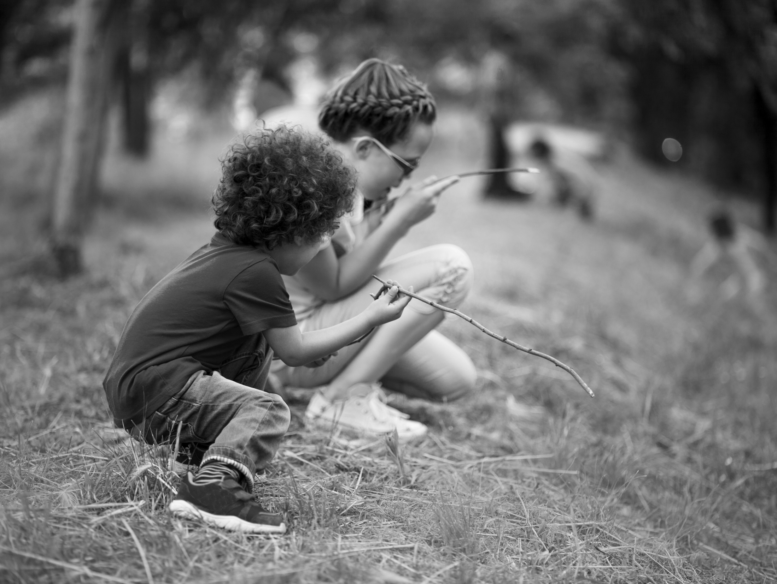
“I don’t like being in nature by myself.”
51% agreed or were neutral
Notes:
To reinforce this point…
51 percent of adults indicated they do not like being in nature by themselves. And these percentages grow for the very audiences you want to reach…urban residents, young and middle-aged adults, and non-whites are the most likely to agree they do not like being in nature by themselves.
Being social means supporting mentorships of all types…inviting pre-existing social groups to programs...and promoting engagement with nature as something fun that you do with other people.
So, Recommendation 1) Redefine connecting with nature. 2) Be social. And 3…

Slide 32
3. Consider similarities and differences
Notes:
Consider similarities and differences. Pay close attention to how Americans are different, and how they are similar, in their relationships with nature.

Slide 33
Similar values and interests in nature
Enjoy nature
Experience it with others
Affection and attraction toward it
Support for programming and funding
Different ways of translating these into action
Concerns about safety
Who is present
Type of activity
Notes:
We found many similarities in Americans’ relationships with nature—across residential location, race and ethnicity, political party, geographic region, and so on. Overall, Americans of all types enjoy nature, like to experience it with others, have deep affection and attraction toward it, and support programming and funding.
[next slide]
But we also found some clear differences, especially in how different groups are
Concerned about safety
Who is present for activities
The type of activity they are interested in

Slide 34
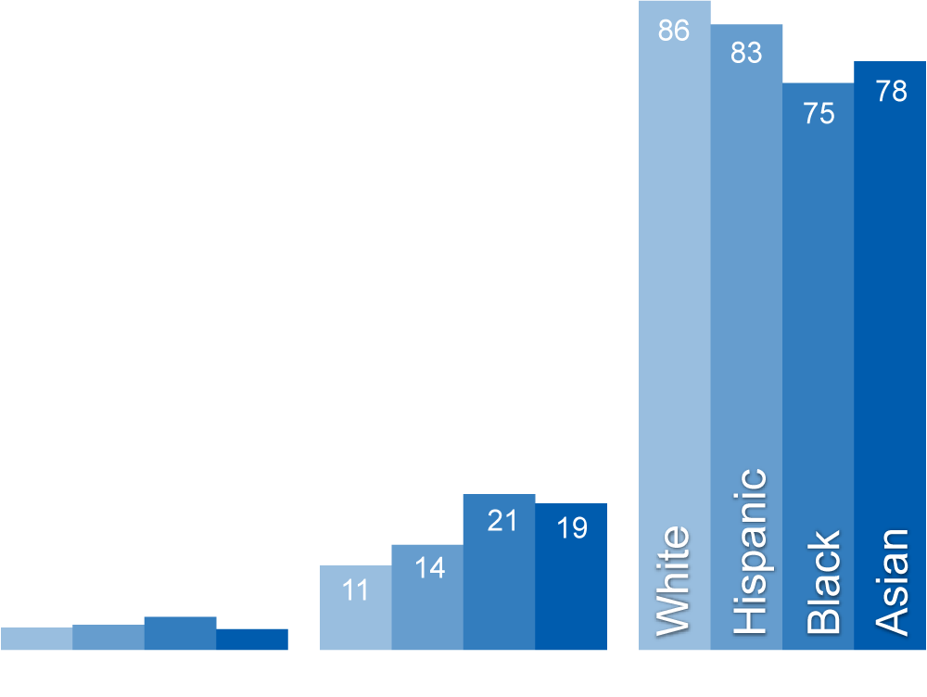
Adults: The intelligence of future generations will suffer if our society becomes more isolated from nature.
Notes:
As an example of similarity, look at the ways adults agree with the statement, “The intelligence of future generations will suffer if our society becomes more isolated from nature.”
This slide shows agreement across race and ethnicity. The differences are not large enough from a management or communications perspective.

Slide 35
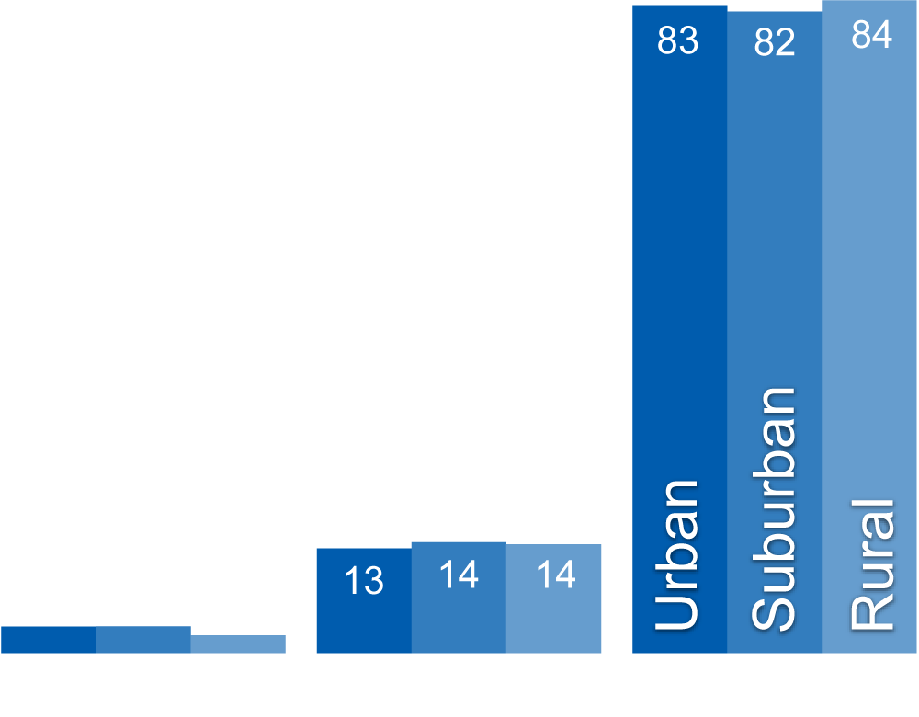
Adults: The intelligence of future generations will suffer if our society becomes more isolated from nature.
Notes:
We also see widespread agreement across residential location.
And I should point out that residential location often surprised us. The patterns we were expecting to find we didn’t see, and this is an example.

Slide 36
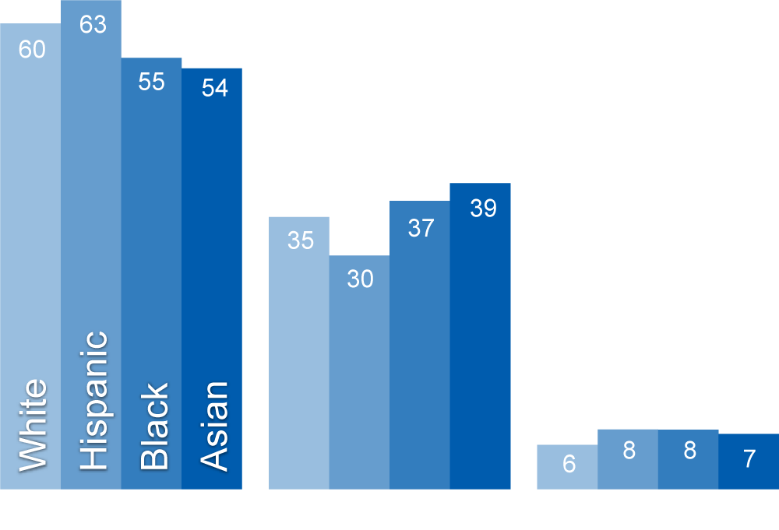
Adults: How would you rate your interest in… Taking a walk outdoors?
Notes:
As an example of difference, though, consider interest in taking a walk outdoors. This was one activity in a long list that we asked adults.
The majority of adults have a lot of interest in taking a walk outdoors. Very few adults have no interest at all.

Slide 37
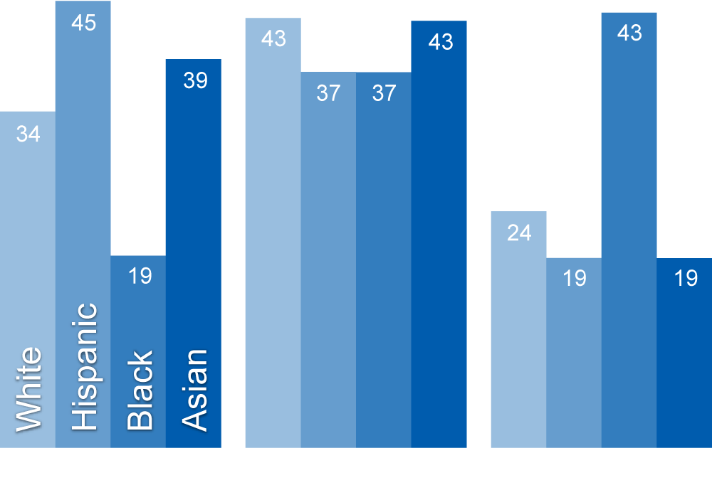
Adults: How would you rate your interest in… Hiking?
Notes:
Now let’s see the difference by changing the activity to hiking.
Walking outdoors versus hiking – it’s not much of a difference to those in the conservation community, but it’s a large one to members of different groups.
[TOGGLE BACK AND FORTH]

Slide 38
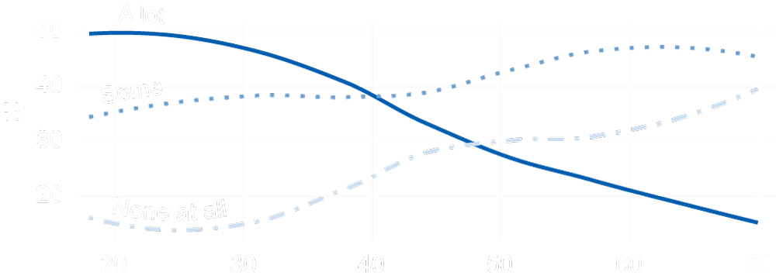
Adults: How would you rate your interest in… Hiking?
Notes:
Here’s another example.
This is a look at interest in hiking among adults across age. Starting at the top left of the graph, note that half of adults in their 20s are highly interested in hiking. That interest declines steadily, until only about 10 percent of adults in their 70s have a lot of interest in it.
So, while Americans are often alike in their interests and values of nature, age, location, and race and ethnicity—and other factors—can be important sources of difference.
[PAUSE]
I’ve recommended 1) redefine connecting with nature, 2) be social, and 3) consider similarities and differences. Recommendation 4 is…

Slide 39
4. Promote multidimensional experiences
Notes:
…Promote multidimensional experiences.
The conservation community often thinks and develops programs based on increasing “recreation” or instilling formal “knowledge” about the natural world. Both of these are critically important and, as you’ve seen, are supported by Americans.
But the American public…adults and children alike care about, experience, and engage with nature in many dimensions.

Slide 40
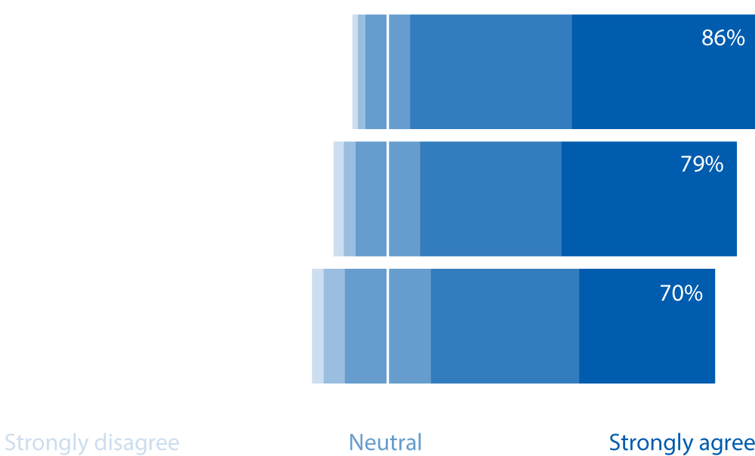
Adults: How much do you agree or disagree with the following statements?
Being in nature gives me a sense of peace
Certain smells and sounds of nature bring to mind some of my happiest memories
Being in nature helps give meaning and purpose to my life
Notes:
Americans value nature “Being in nature gives me a sense of peace” (86% somewhat or strongly agrees with that statement). They hold strong affection toward nature in different ways. They find being in nature gives meaning and purpose to their lives.
These questions, and a host of others, show Americans want to engage in nature in a variety of ways.
When you all look at these statements as conservationists, you see your values represented…I think it’s really gratifying to see Americans share those to a degree you probably didn’t expect.

Slide 41
5. Claim a seat at the table
Notes:
Finally, recommendation 5: Claim a seat at the table.
If you just talk about hunting or fishing or wildlife viewing as recreational activities or wildlife management tools (as vitally important as those are to conservation), you don’t have a seat at the table where the big issues are being discussed…health care, education, transportation, urban planning. And, these are the arenas in which decisions are being made that have large-scale impacts on people, on the landscape, and where those two things intersect.
If you want to work to overcome these massive societal problems, if you want to have an influence far larger than your current budgets, then you’ll need to claim a seat at the table.
The big question for the conservation community becomes: How do you build partnerships with the education system and the healthcare system, with community developers and with tourism boards, so that you are expanding your impact in ways that promote socially oriented, routine contact with nature?

Slide 42
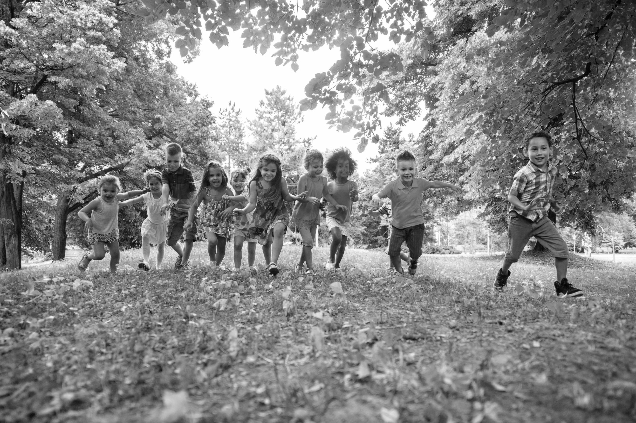
Notes:
I spoke with Dr. Kellert for the last time on November 17, 2016, 10 days before he passed away.
He was in the hospital, but during the call, we jumped back and forth talking about his medical treatment and about the Initiative. Toward the end of that conversation, Steve was reflecting on the results of the research and said, “We probed more about what it means to be a human being.”

Slide 43
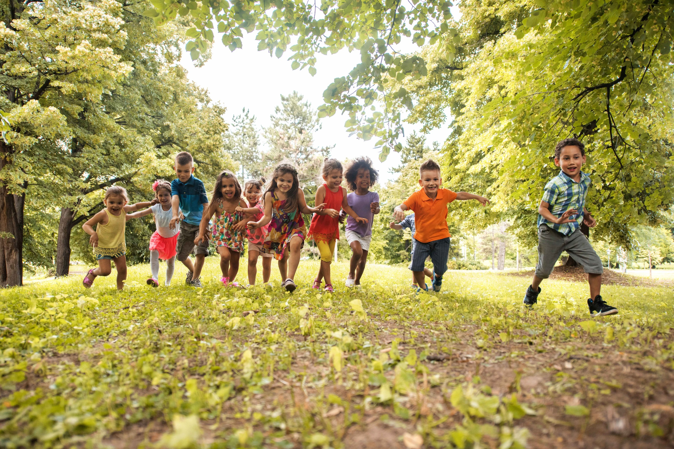
Human flourishing
Notes:
You are in the business of human flourishing.
Is that too sweeping of a comment? Perhaps. But, Steve Kellert didn’t think so and neither do I. More importantly, neither does the American public.
You, the conservation community, are not just in the business of providing a place for nature to thrive. You are not just in the business of overseeing recreational activities.
When you conserve species and when you protect and restore habitats, you are in the business of helping Americans live happier, healthier lives. You are in the business of helping children develop socially, psychologically, and physically. You are in the business of helping create places where Americans want to live, work, and flourish.
Connection to nature and wildlife is fundamental to the economic and social wellbeing of our country and a critical component of American culture and history.
For those of us here in this room, nature is not just a dispensable amenity. It is woven into the story of our lives, individually and as a community.
We must make that a reality for all Americans—regardless of where they live or who they are.

Slide 44
NatureofAmericans.org

